Slide 1

Notes:
Copyright 2020 Maps4HomeSchool.com

Slide 2
This presentation is designed so that your students can edit text in certain areas (like this).
It includes 3 Simple challenges and 2 Advanced.
Notes:
Copyright 2020 Maps4HomeSchool.com

Slide 3
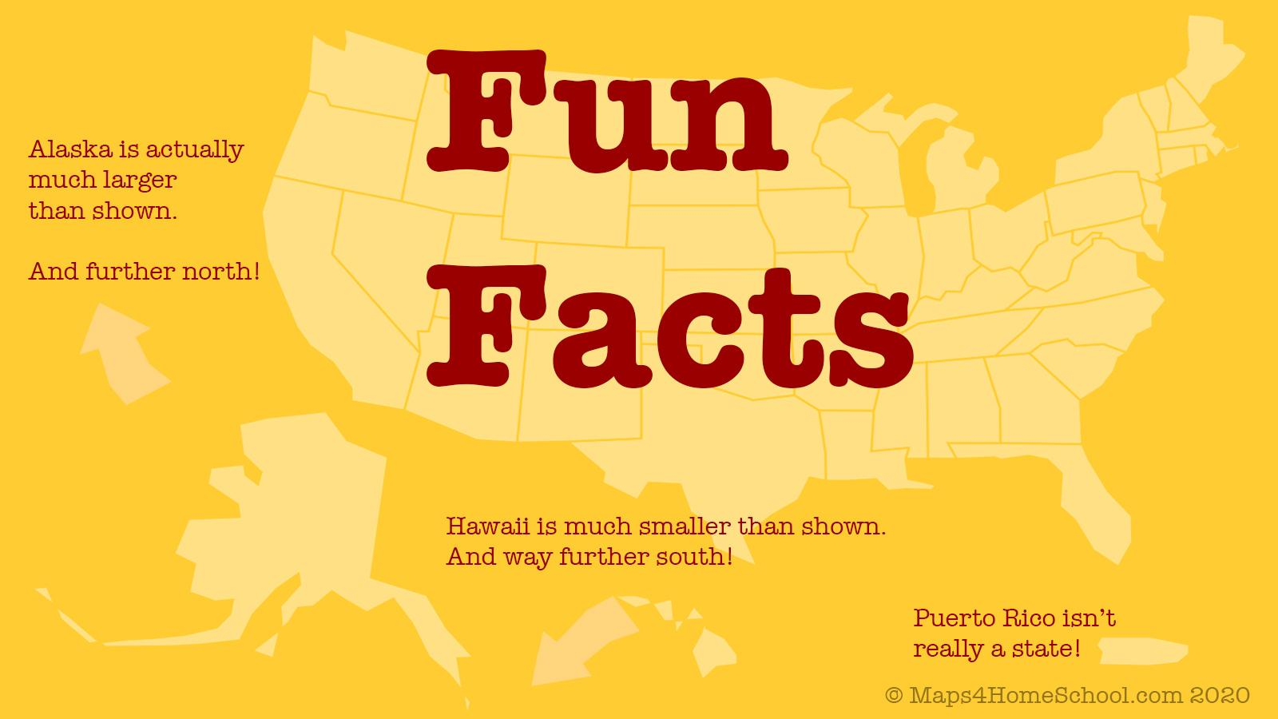

Slide 4
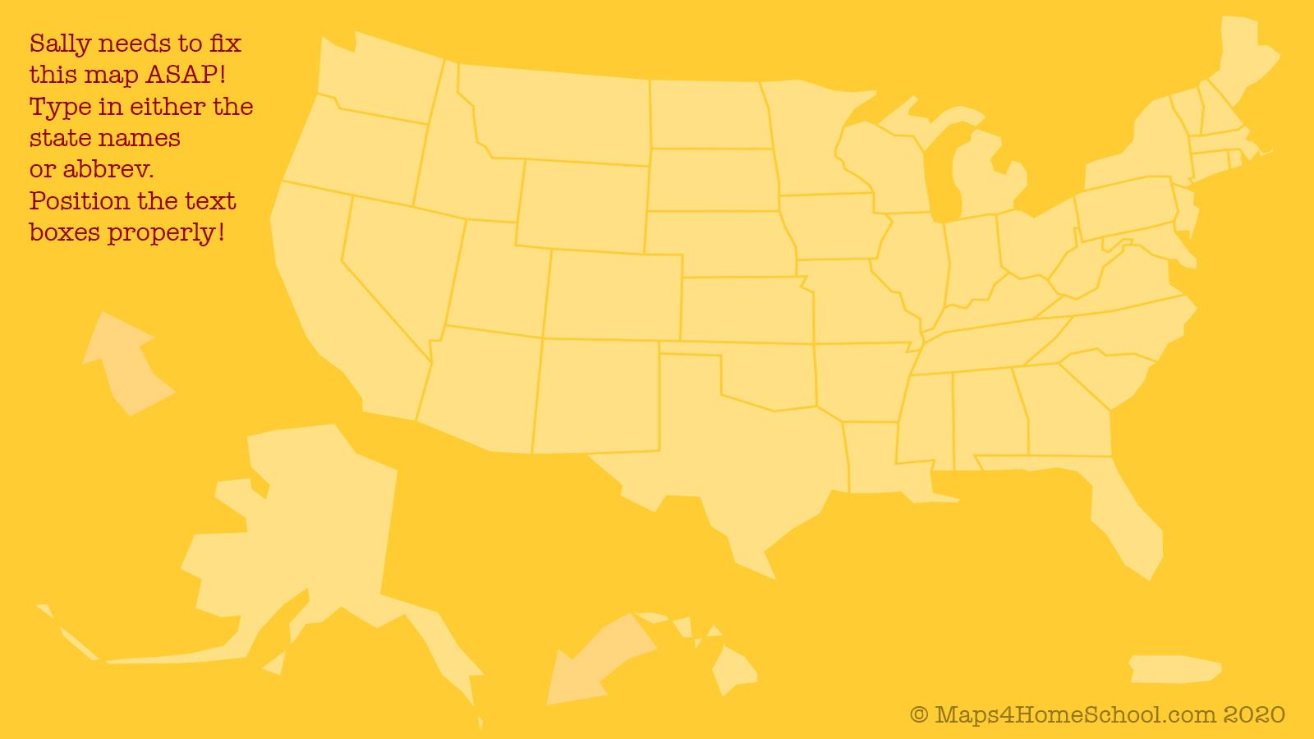
?
?
?
?
?
?
?
?
?
?
?
?
?
?
?
?
?
?
?
?
?
?
?
?
?
?
?
?
?
?
?
?
?
?
?
?
?
?
?
?
?
?
?
?
?
?
?
?
?
?
?
Notes:
Alabama - AL
Alaska - AK
Arizona - AZ
Arkansas - AR
California - CA
Colorado - CO
Connecticut - CT
Delaware - DE
Florida - FL
Georgia - GA
Hawaii - HI
Idaho - ID
Illinois - IL
Indiana - IN
Iowa - IA
Kansas - KS
Kentucky - KY
Louisiana - LA
Maine - ME
Maryland - MD
Massachusetts - MA
Michigan - MI
Minnesota - MN
Mississippi - MS
Missouri - MO
Montana - MT
Nebraska - NE
Nevada - NV
New Hampshire - NH
New Jersey - NJ
New Mexico - NM
New York - NY
North Carolina - NC
North Dakota - ND
Ohio - OH
Oklahoma - OK
Oregon - OR
Pennsylvania - PA
Rhode Island - RI
South Carolina - SC
South Dakota - SD
Tennessee - TN
Texas - TX
Utah - UT
Vermont - VT
Virginia - VA
Washington - WA
West Virginia - WV
Wisconsin - WI
Wyoming - WY

Slide 5
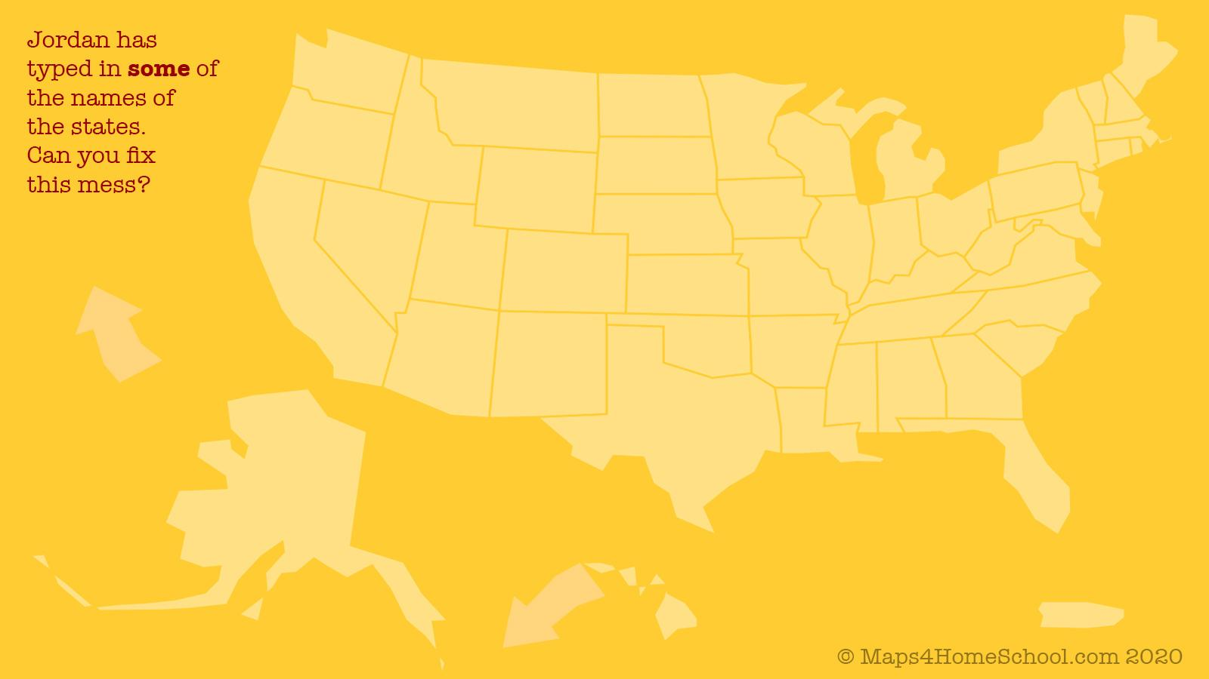
?
maine
Washing
ND
?
montana?
?
ny
oregon
wisconsin?
ma
Idaho
sd
?
?mi
wyoming?
?iowa
?
ct?
oh
?
de
?
?
?
il
nevada
?kansas
indi?
cali
co
?utah
nc
arzona
?
?ok
?
geor?
sc
nm
alabam?
?
?tex
lous?
?
?fl
?
HAWAII
Puerto Rico
Notes:
Alabama - AL
Alaska - AK
Arizona - AZ
Arkansas - AR
California - CA
Colorado - CO
Connecticut - CT
Delaware - DE
Florida - FL
Georgia - GA
Hawaii - HI
Idaho - ID
Illinois - IL
Indiana - IN
Iowa - IA
Kansas - KS
Kentucky - KY
Louisiana - LA
Maine - ME
Maryland - MD
Massachusetts - MA
Michigan - MI
Minnesota - MN
Mississippi - MS
Missouri - MO
Montana - MT
Nebraska - NE
Nevada - NV
New Hampshire - NH
New Jersey - NJ
New Mexico - NM
New York - NY
North Carolina - NC
North Dakota - ND
Ohio - OH
Oklahoma - OK
Oregon - OR
Pennsylvania - PA
Rhode Island - RI
South Carolina - SC
South Dakota - SD
Tennessee - TN
Texas - TX
Utah - UT
Vermont - VT
Virginia - VA
Washington - WA
West Virginia - WV
Wisconsin - WI
Wyoming - WY

Slide 6
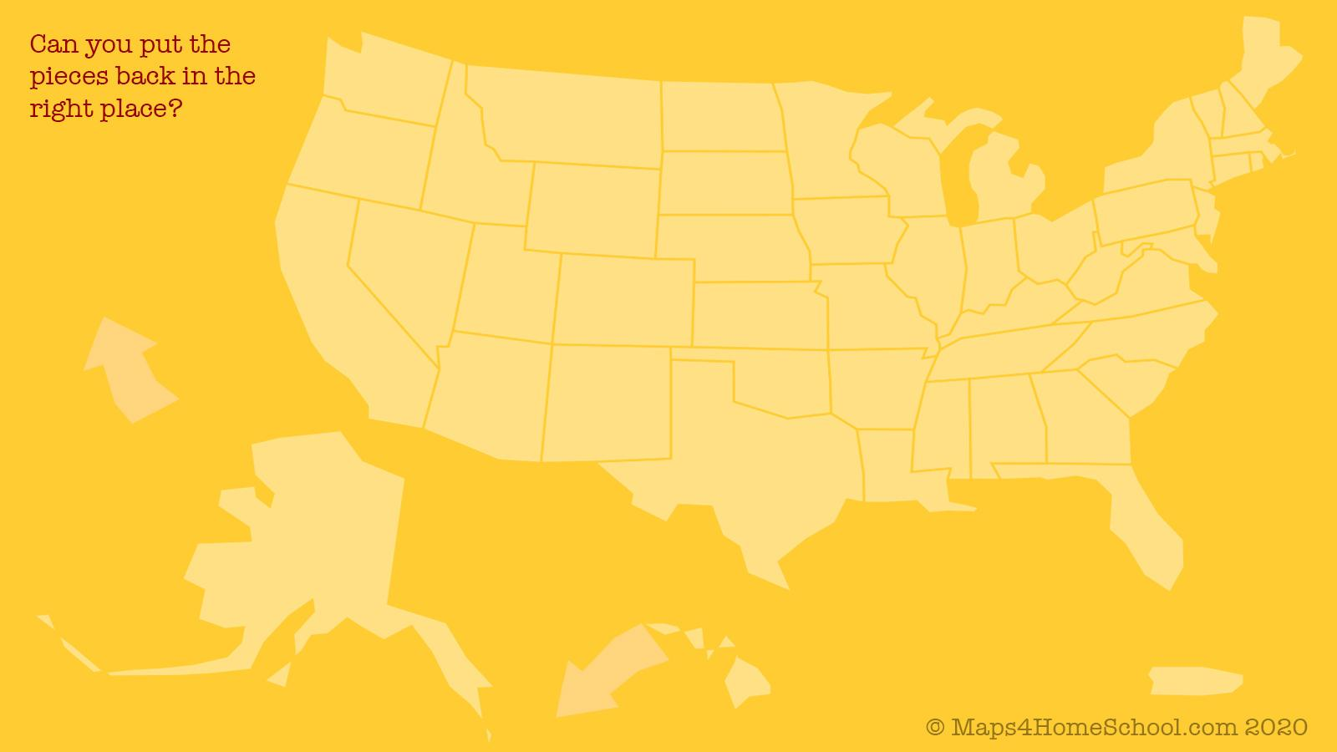
Notes:
See how fast you can do this!

Slide 7
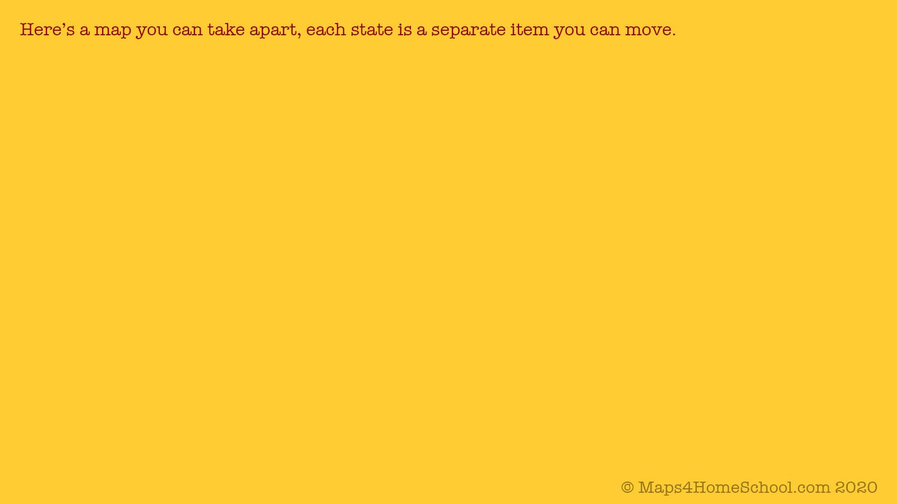

Slide 8
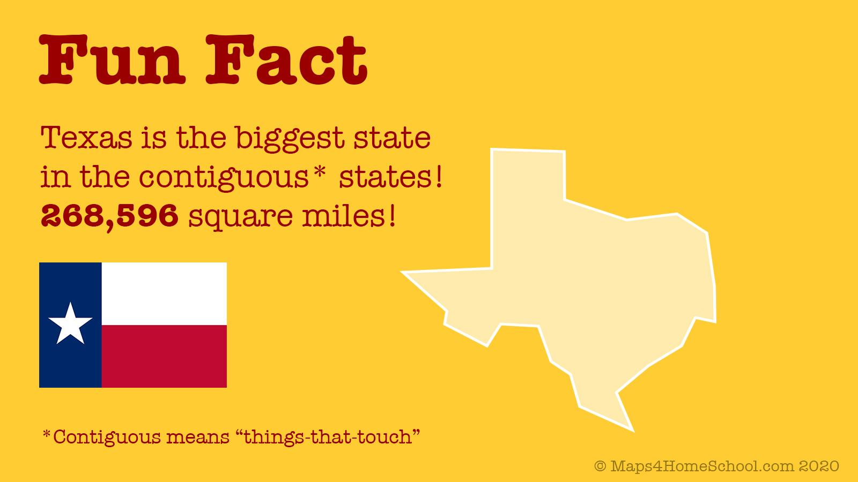
about Texas

Slide 9

about your favorite state
Now, you write your own fun fact about a state! How about the one you live in or the one you visited most recently? (You can edit this text here and above!)
You can copy a state from that slide you saw earlier, and paste it right here, OK?

Slide 10
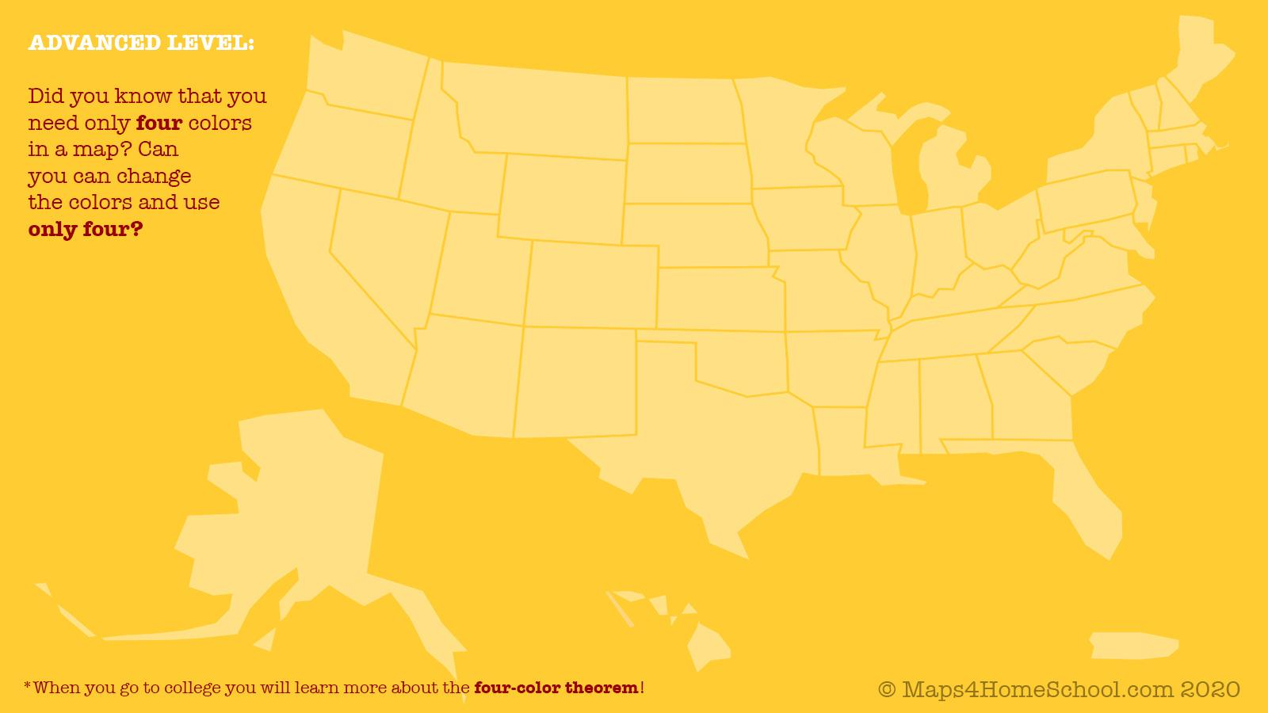

Slide 11
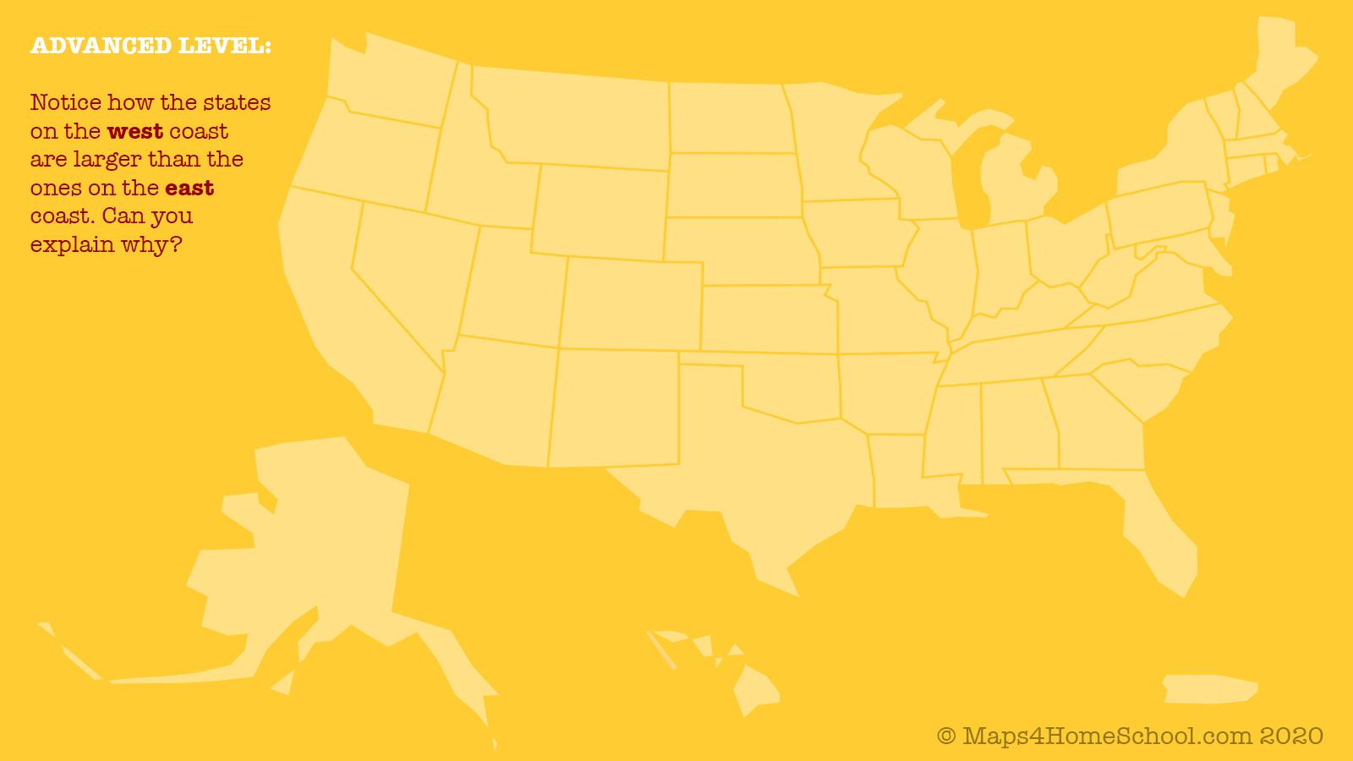
I think that the states on the east coast are smaller because...

Slide 12
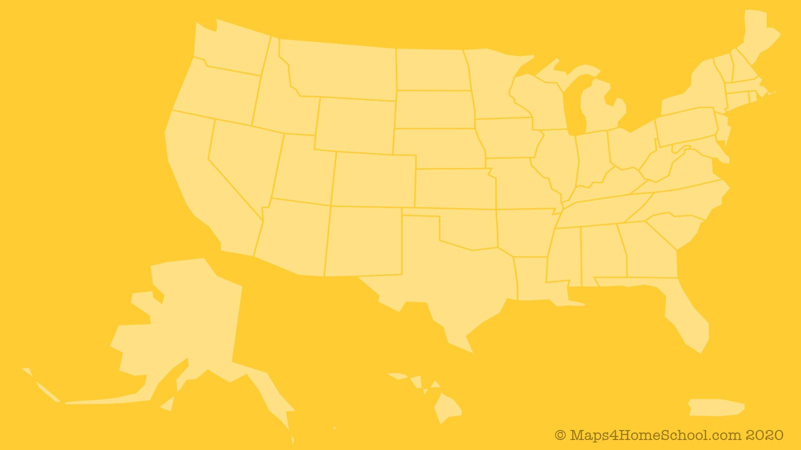
This is a basic background with all of the states that can be pulled apart.
Use it to make
your own slides!

